Slide 1


Molecular Interactions and Network Analysis From raw data to network analysis: PSICQUIC and Cytoscape
Pablo Porras Millán, IntAct

Slide 2
Session outline
Protein interactions and PPI databases introduction
IntAct as an example of a PPI database
The problem of data integration and PSICQUIC
Network representation and analysis: strategies and limitations.
Introduction to Cytoscape
Cytoscape hands-on session:
Importing and representing PPI data.
Representing external information in a network.
Topological analysis: cluster search with clusterMaker2.
GO enrichment analysis using the BiNGO app.

Slide 3
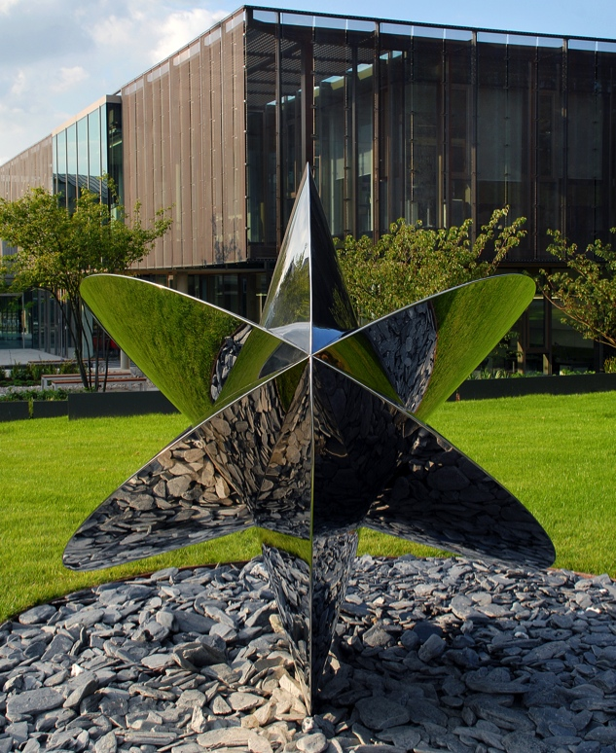
What is EMBL-EBI?
Part of the European Molecular Biology Laboratory
International, non-profit research institute
Europe’s hub for biological data services and research

Slide 4
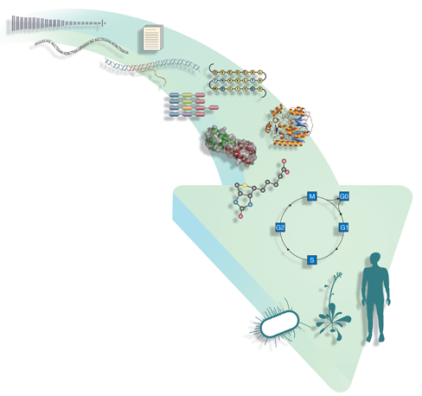
Data resources at EMBL-EBI
Literature & ontology
Europe PubMed Central
Gene Ontology
Genomes & variation
Ensembl
Ensembl Genomes
Genome-phenome archive
Metagenomics
Nucleotide sequences
European Nucleotide Archive (ENA)
Expression
Array Express
Expression Atlas
PRIDE
R-Workbench
Molecular structures
Protein Data Bank in Europe
PDBsum
ProFunc
Proteins
The Universal Protein Resource (UniProt)
InterPro
Chemical biology
ChEMBL
ChEBI
Systems
BioModels
Enzyme Portal
BioSamples
Patent sequences
Non-redundant patent sequence dbs
Patent compounds
Pathways
IntAct
Reactome
Metabolights

Slide 5
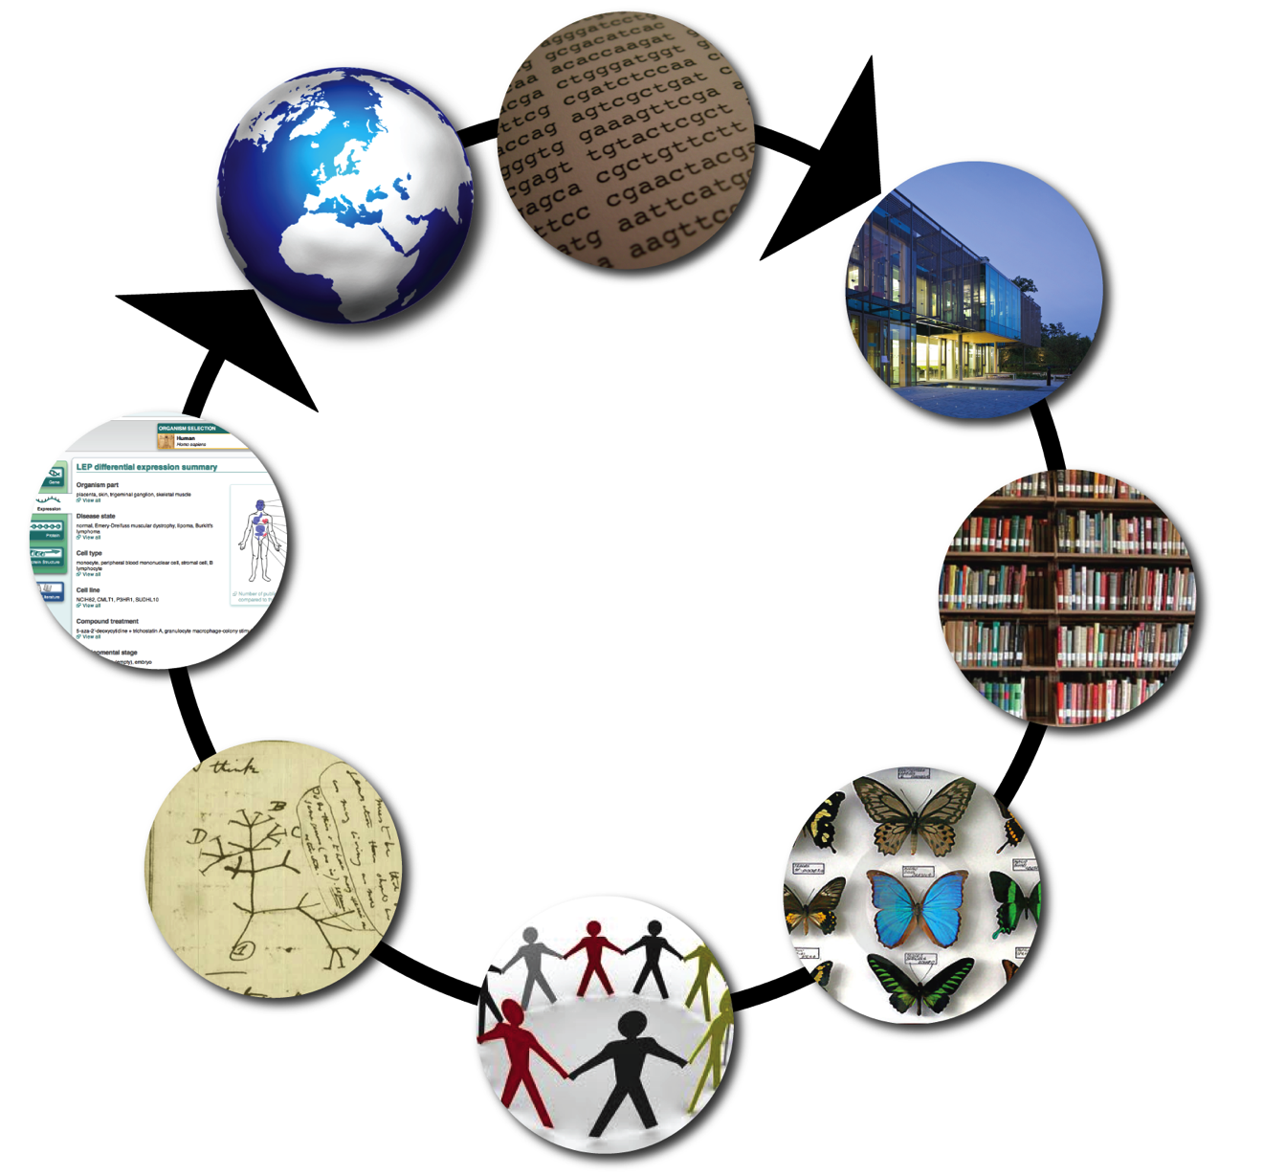
What services do we provide?
Labs around the world send us their data and we…
…provide tools to help researchers use it
A virtuous circle
Archive it
Analyse it
Classify it
Share it with other data providers

Slide 6
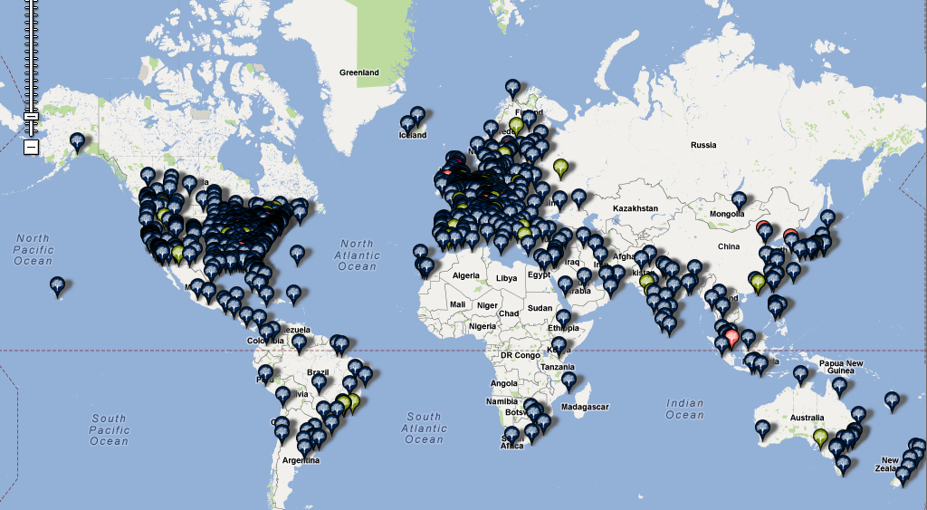
EMBL-EBI users: a snapshot

Slide 7
Introduction to protein-protein interactions (PPIs) and PPI databases

Slide 8
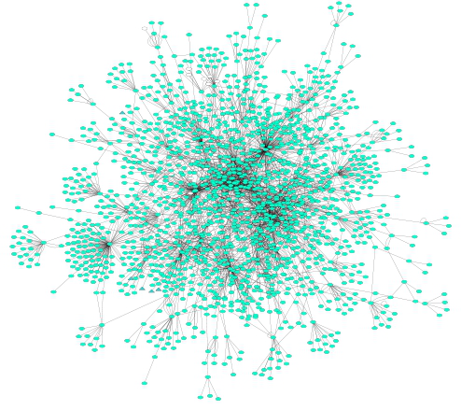
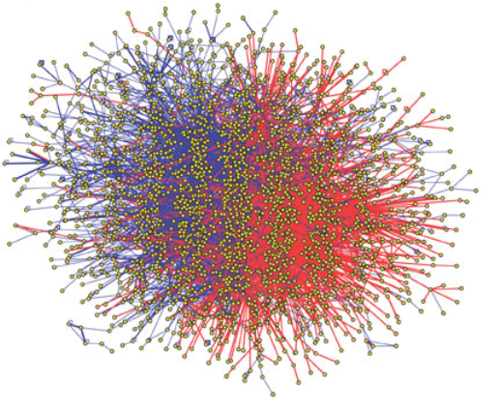
A couple of definitions…
Protein-protein interactions (PPIs): physical and selective contacts that happen between pairs of proteins, in certain molecular regions and in a defined biological context.
Interactome: the totality of PPIs that happen in a cell / in an organism / in a specific biological context...
Protein-protein interaction network: Graphical representation of a group of PPIs in which proteins are represented as nodes and interactions as edges.

Slide 9
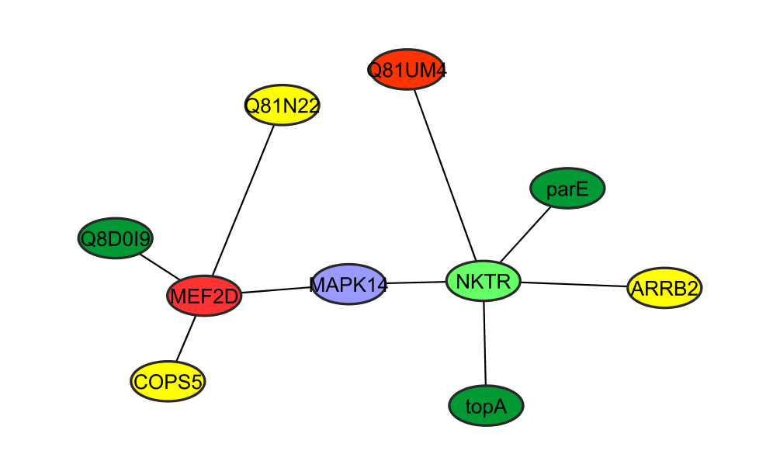
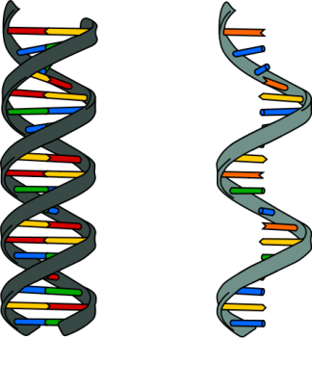
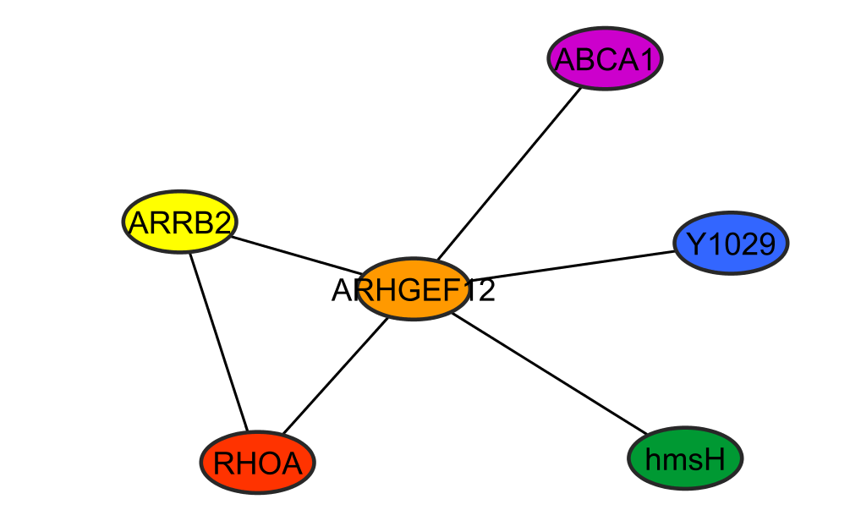
Why protein-protein interactions?
Gene level
Protein level
DNA
RNA
1 protein
=
n functions
=
n networks!
1 protein
=
1 function
WRONG!
To predict a protein biological function
“guilt by association”
proteins with similar functions should cluster together
To improve characterization of protein complexes and pathways
interaction networks work as a draft map that brings detail to biological processes and pathways

Slide 10
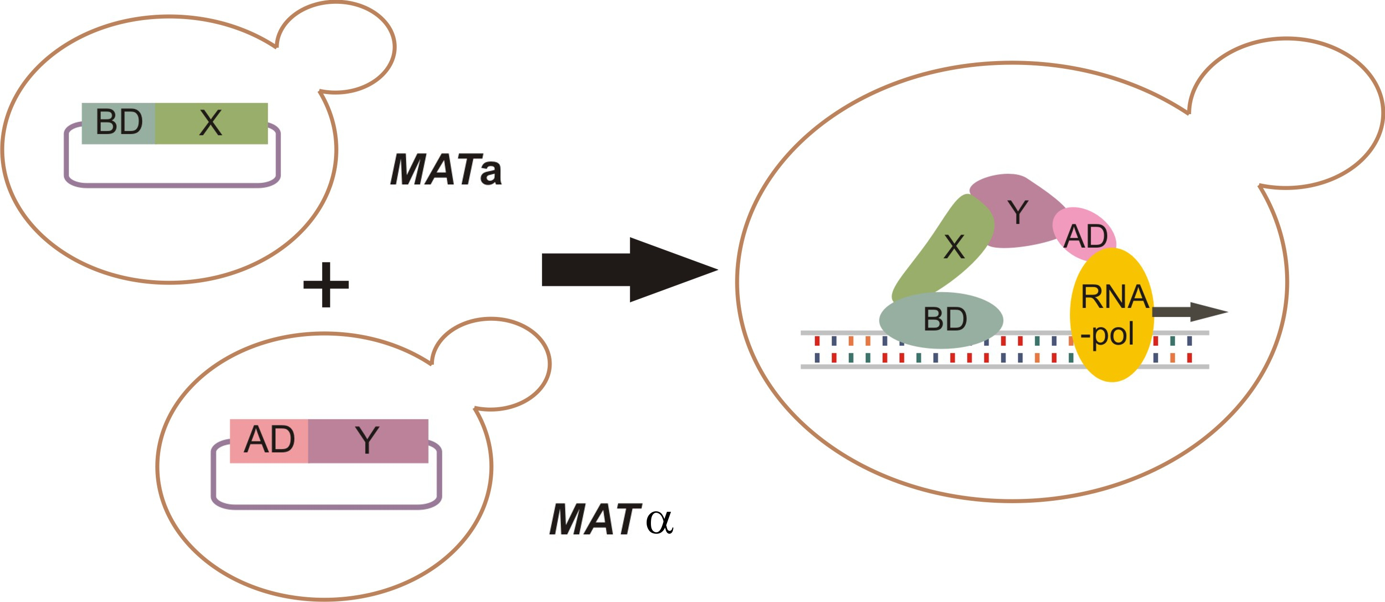
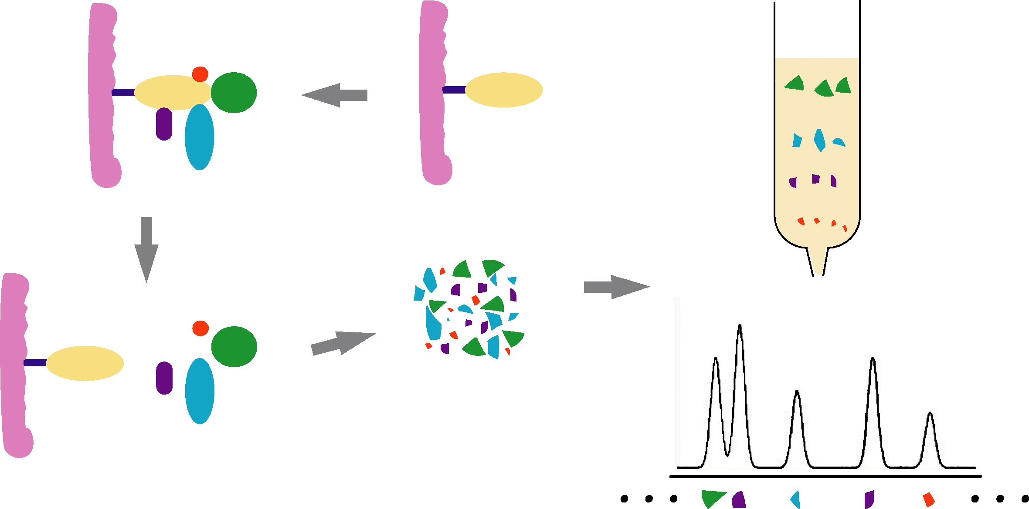
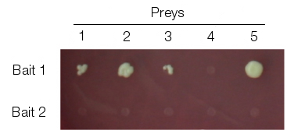
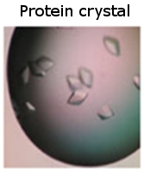
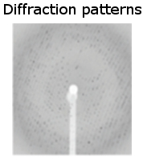
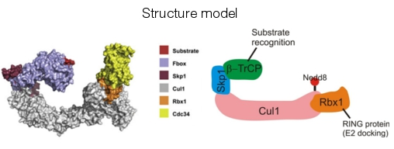
Protein-protein interaction detection methods
Yeast-two hybrid (Y2H)
Tandem affinity purification+ mass spectrometry (TAP-MS)
No single method can accurately reproduce a true binary interaction observed under physiological conditions – every interaction detected experimentally is fundamentally artefactual.
High-throughput
X-ray diffraction studies
Low-throughput
Notes:
There are multiple types of experimental methods used to detect protein-protein interactions. Two methods are important due to their use in high-throughput studies: these are the yeast two hybrid complementation assay (Y2H) and tandem-affinity purification followed by mass spectrometry (TAP-MS). Y2H is a fast, inexpensive and scalable method to detect binary interactions. TAP-MS will detect of multi-protein (n-ary) interactions. Other approaches that are less amenable to high-throughput setups are used in small-scale studies and provide more detailed structural and chemical information about the interaction.
Credits for structure model:
Cullin-complex model from Kleiger et al., Cell 139, 957-968, 2009.

Slide 11
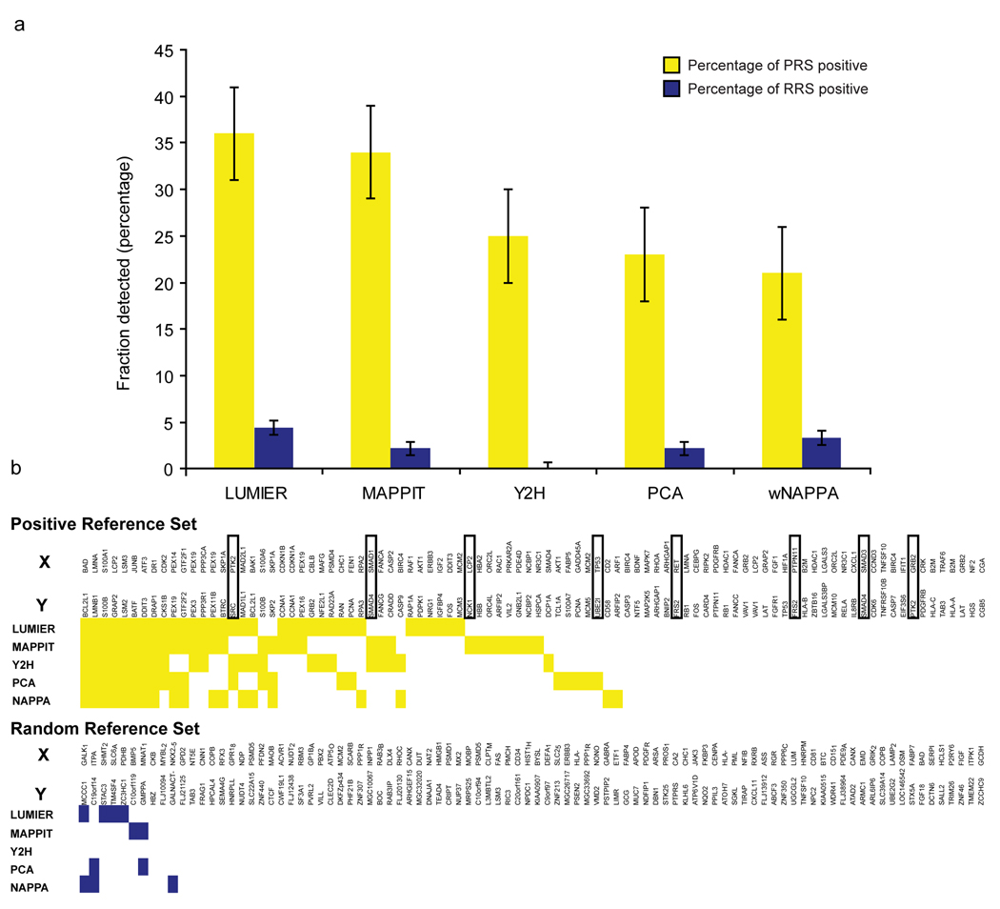
Protein-protein interaction detection methods
Braun et al., Nat Methods, 2008, PMID: 19060903.

Slide 12
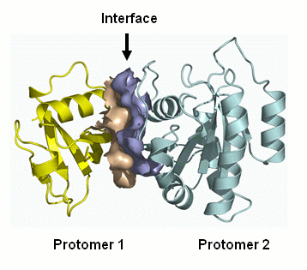
Representing PPIs: interaction domains
interaction domains
Overlap in sequence ranges:
Notes:
We can specifically describe interacting domains down to the residue level.
The domain can be represented as the specific range of the underlying amino acid sequence.
Including required PTM
These ranges are remapped whenever UniProtKB updates their protein sequences.

Slide 13
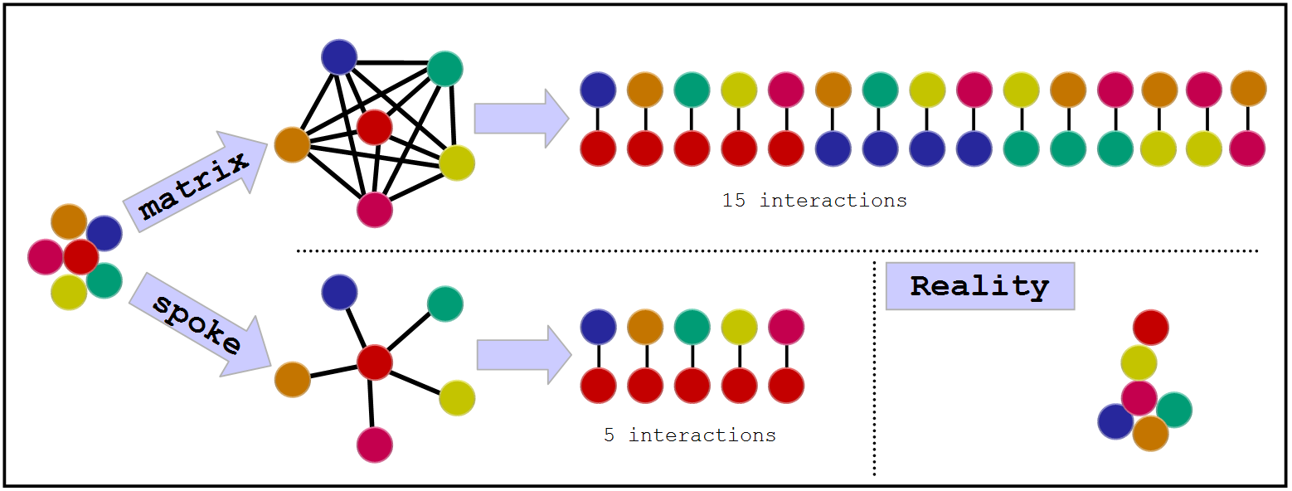
Representing PPIs:
The problem with complexes
Some experimental methods generate complex data: E. g. Tandem affinity purification (TAP)
There are two algorithms to transform this information into binary data:
Notes:
Computational tool to aid searches,
Transforms n-ary interaction into binary,
Both are somewhat wrong, spoke is said to generated 3 times less false positive (Bader et al.).

Slide 14









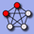

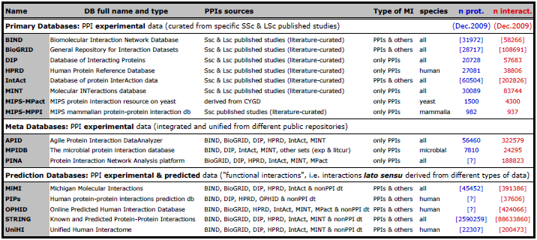
Interactions databases: types
De Las Rivas & Fontanillo, PLoS Computational biology, PMID: 20589078.

Slide 15


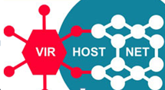
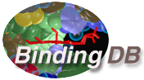

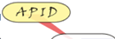


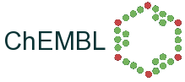


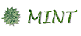

Databases: curation levels
SHALLOW
CURATION
DEEP CURATION

Slide 16
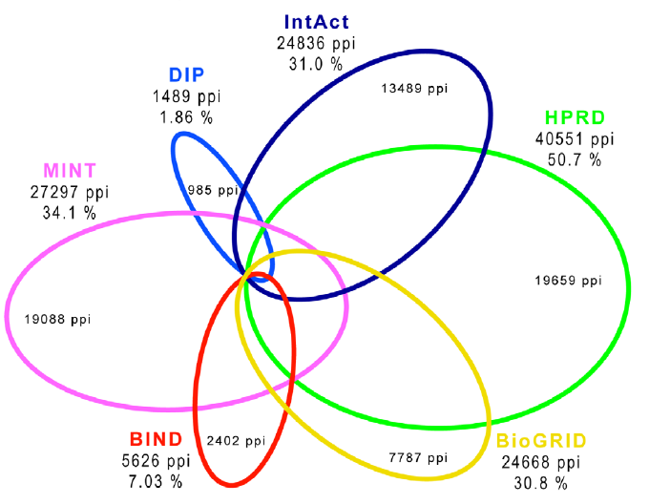
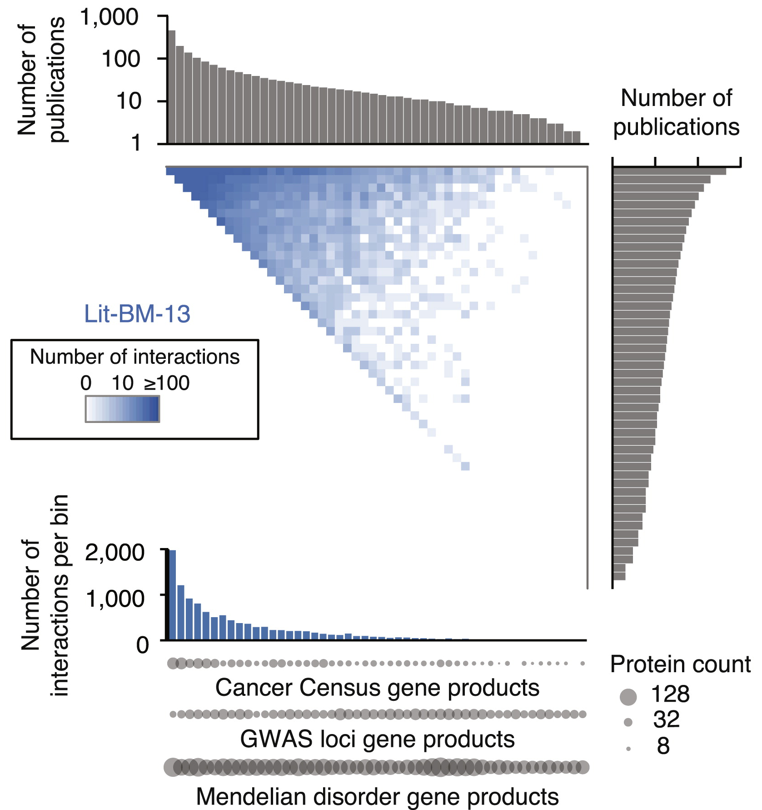
Primary databases: coverage and biases
Human PPIs coverage in the main public primary databases
(Dec 2009)
Popularity bias in publicly available databases
(2013)
Roland et al., Cell, PMID: 25416956.
De Las Rivas & Fontanillo, PLoS Computational biology, PMID: 20589078.

Slide 17
IntAct: The molecular interactions database at the EBI

Slide 18
IntAct goals & achievements
Publicly available repository of molecular interactions (mainly PPIs) - >560K binary interaction evidences taken from >13,800 publications (November 2015)
Data is standards-compliant and available via our website, for download at our ftp site or via PSICQUIC www.ebi.ac.uk/intact
ftp://ftp.ebi.ac.uk/pub/databases/intact
www.ebi.ac.uk/Tools/webservices/psicquic/view/main.xhtml
Provide open-access versions of the software to allow installation of local IntAct nodes.
Notes:
(!) needs updating of the stats whenever giving the talk http://www.ebi.ac.uk/intact/statisticView
Goals as set in 2002
How did we address them (in red)

Slide 19

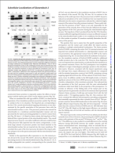
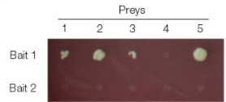
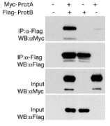




IntAct:
Data storage schema
Entry
[A] Publication level (entry)
Publication
Experiment 1
[B] Experiment level
Experiment 2
[C] Interaction level
Interaction 1
Interaction 2
Interaction 3
Interaction 4
…
…
…
[D] Participant level
Participant 1
Participant 2
[E] Feature level
Features
Features
Notes:
This is a schema of how interaction data is stored in IntAct. Each entry in the database corresponds to a publication [A], that is, a scientific article that is curated by the IntAct team. The information in the paper is analyzed and those experiments that contain molecular interactions are represented in the database (experiment level, [B]). Each experiment corresponds to one or more interactions identified in the same organism using the same techniques. The interactions in each experiment are then listed in the interaction level [C], adding information such as kinetic binding parameters, if they were given by the authors. Each participant is identified using cross-references to existing resources such as UniProt or CheBI, if possible, and represented in the participant level [D]. Finally, features of each participant such as binding sites, tags, mutations affecting the interaction or post-translational modifications can be depicted in detail in the feature level [E].

Slide 20

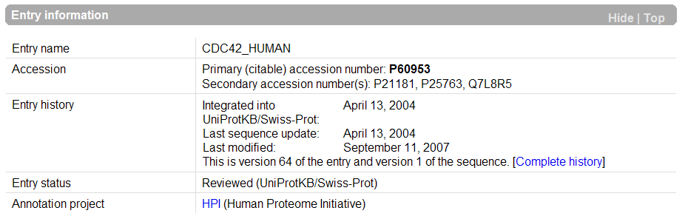
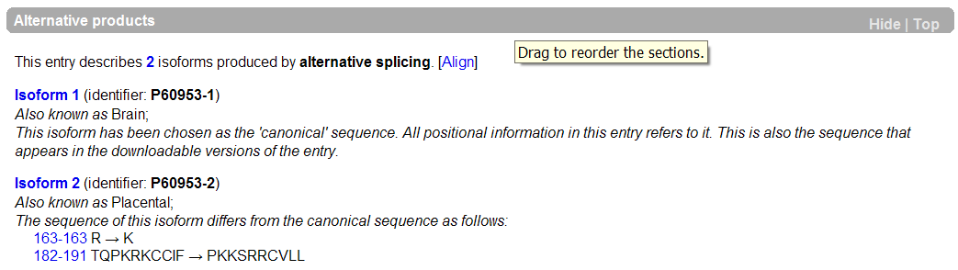
UniProt Knowledge Base
Interactions can be mapped to the canonical sequence…
... to splice variants...
... or to post-processed chains
www.uniprot.org
Notes:
Here we can see:
Primary and secondary ACs
That the entry comes from SwissProt
And 2 splice variants each of which have they own stable identifier and sequence
Note: we annotate down to the splice variant only if it is mentioned in the paper or if we find a sequence match In some cases this allows us to say that one splice variant interact and an other one doesn’t.

Slide 21
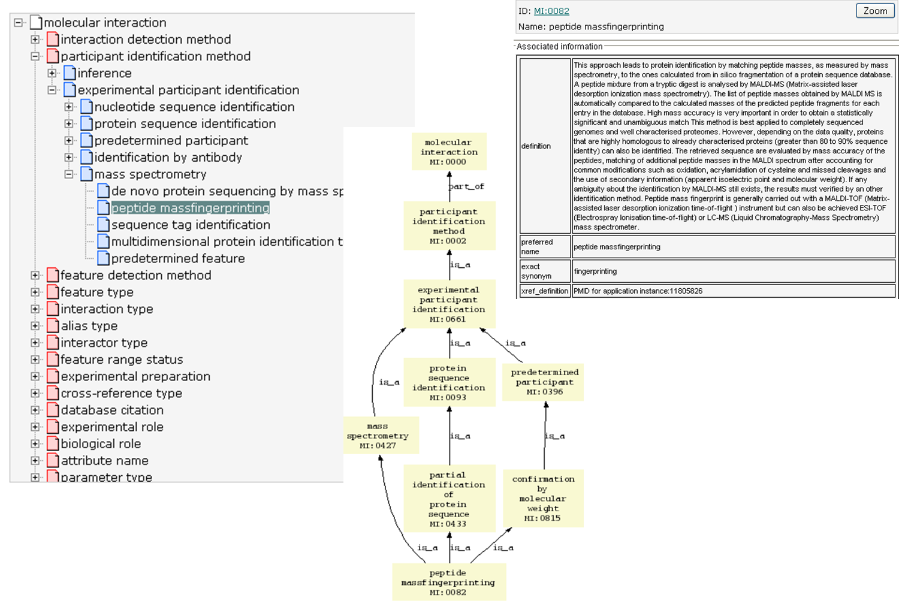
IntAct: PSI-MI ontology

Slide 22


IntAct Curation pipeline
“Lifecycle of an Interaction”
Sanity Checks (nightly)
reject
Public web site
Publication
(full text)
.
exp
annotate
accept
FTP site
p2
I
p1
IMEx
CVs
check
Curation manual
MatrixDB
Mint
DIP
report
report
curator
Super curator
Notes:
22
Tell them that we also export some data for text-miners !

Slide 23





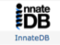






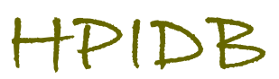
IntAct as a common curation platform
General curation, domain int.
General curation, large scale
UniProt entry related
Extracellular matrix
Model organisms
Immune system
Commercial curation
Cellular mechanics
Regulatory interactions
Specific curation focus/expertise
Host – pathogen interactions
Cardiovascular proteins
Common curation platform
Other DBs
Specific Data Dissemination Platforms

Slide 24
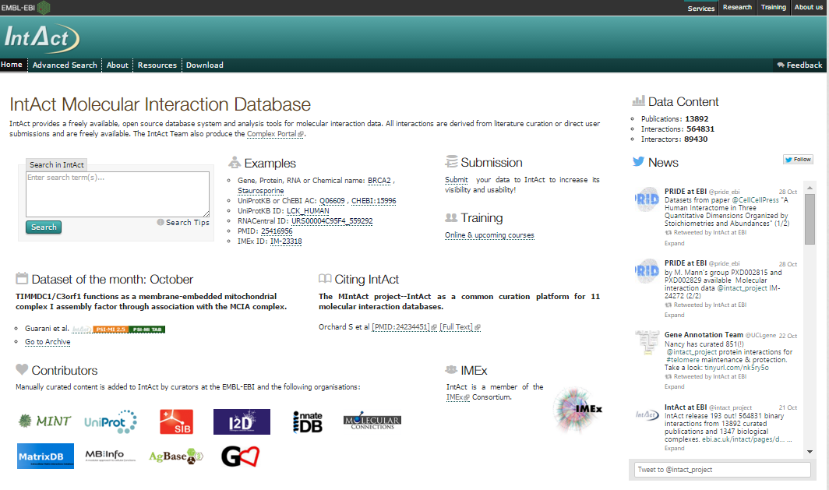
IntAct – Home Page
www.ebi.ac.uk/intact

Slide 25
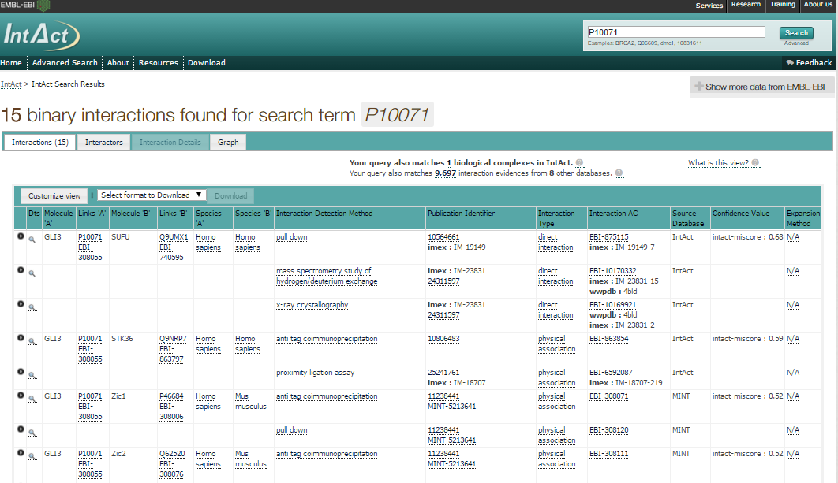
IntAct webpage-based search
Details of interaction
Link to external resource
(UniProtKB)
Details about controlled vocabulary term describing interaction detection method

Slide 26
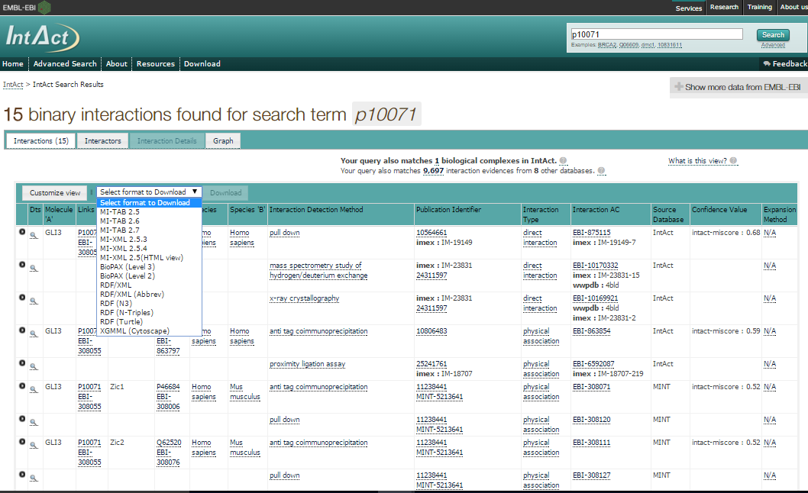
IntAct: download formats

Slide 27
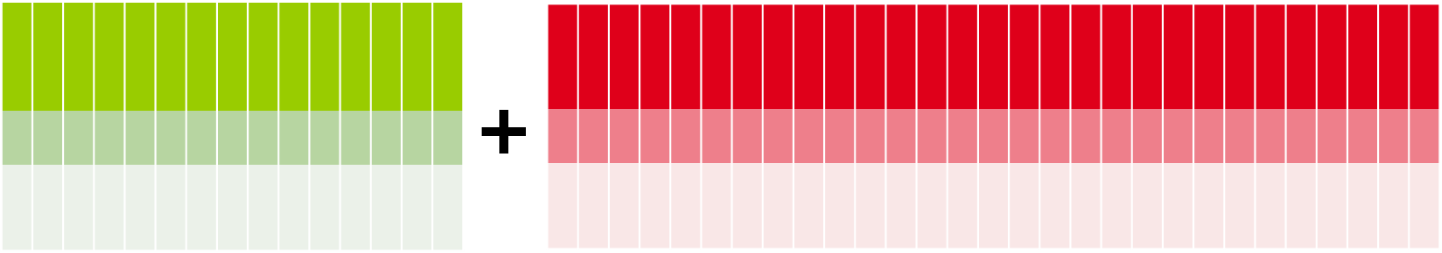
PSIMITAB Columns
MITAB 2.5 Standard columns (15):
MITAB 2.7 specific columns (+27):
Expansion method(s)
Biological role(s) of interactors
Experimental role(s) of interactors
Type(s) of interactors
Properties (CrossReference) of interactors / interaction
Annotation(s) of interactors / interaction
HostOrganism(s)
Parameters of interaction
Creation and update dates
Checksum(s) of interactors / interaction
Negative
Feature(s) interactors
Stoichiometry(s) interactors
Participant(s) identification method(s)
ID(s) interactor A & B
Alt. ID(s) interactor A & B
Alias(es) interactor A & B
Interaction detection method(s)
Publication 1st author(s)
Publication Identifier(s)
Taxid interactor A & B
Interaction type(s)
Source database(s)
Interaction identifier(s)
Confidence value(s)

Slide 28
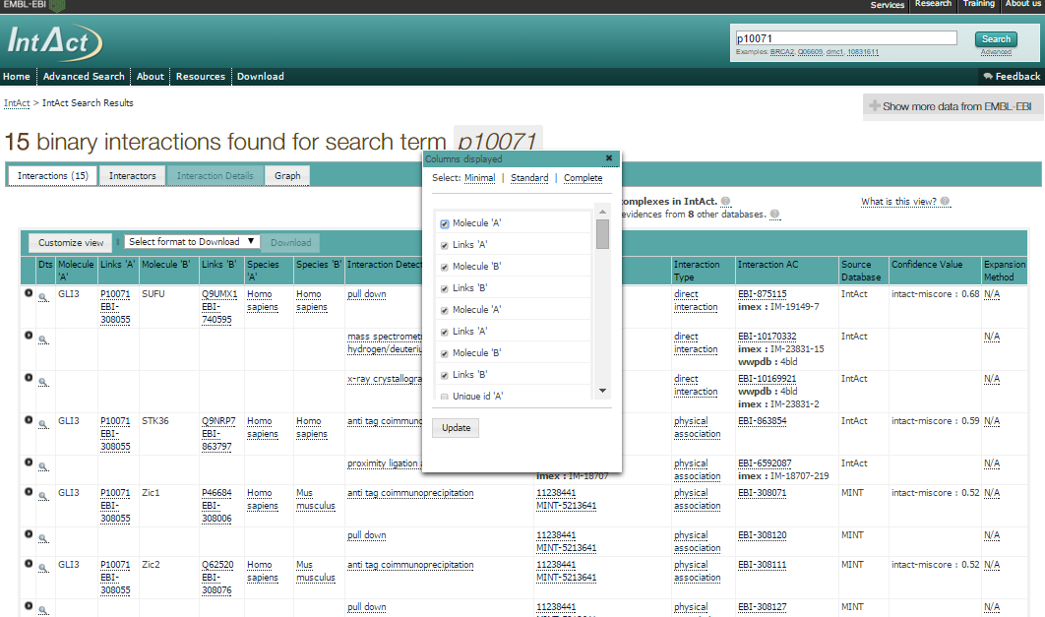
IntAct: changing the layout

Slide 29
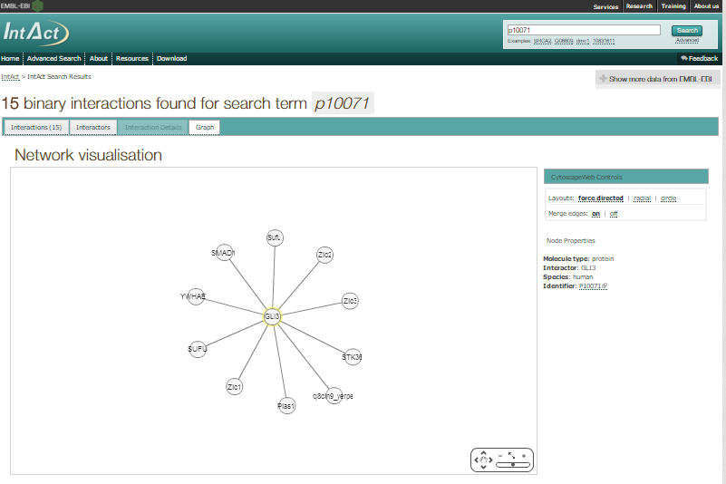
IntAct: visualizing results as a network

Slide 30
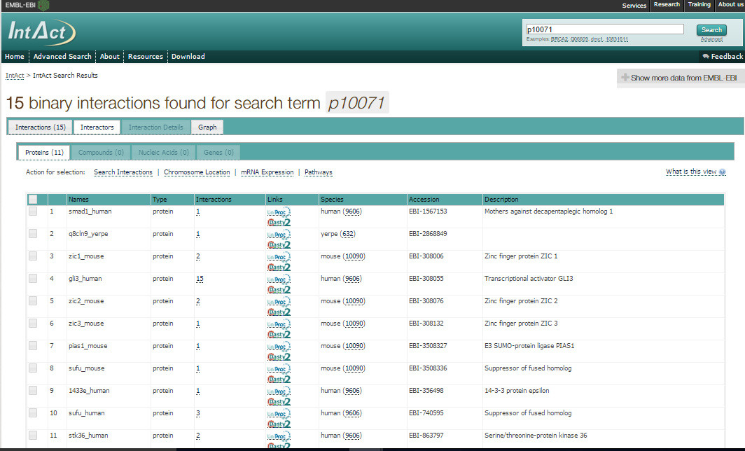
IntAct: list of interactors

Slide 31
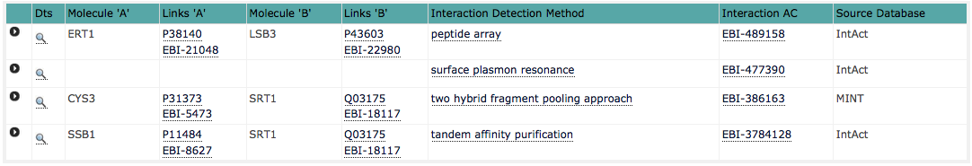
Interaction detail in IntAct

Slide 32
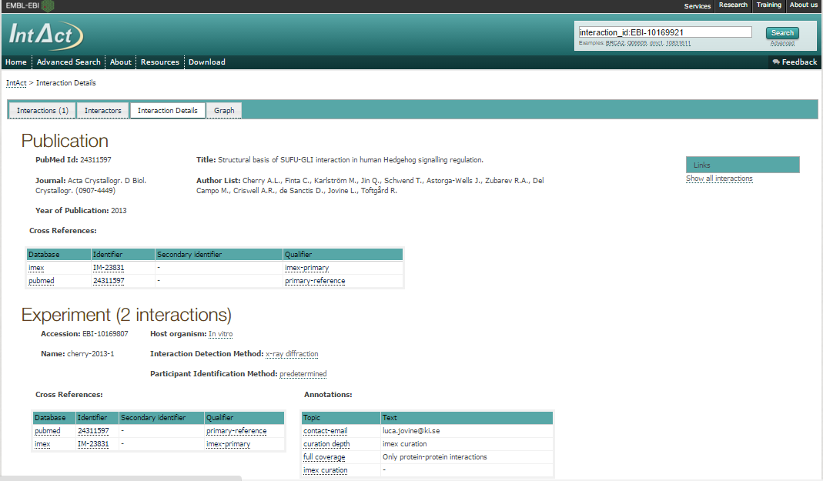
Interaction detail in IntAct

Slide 33
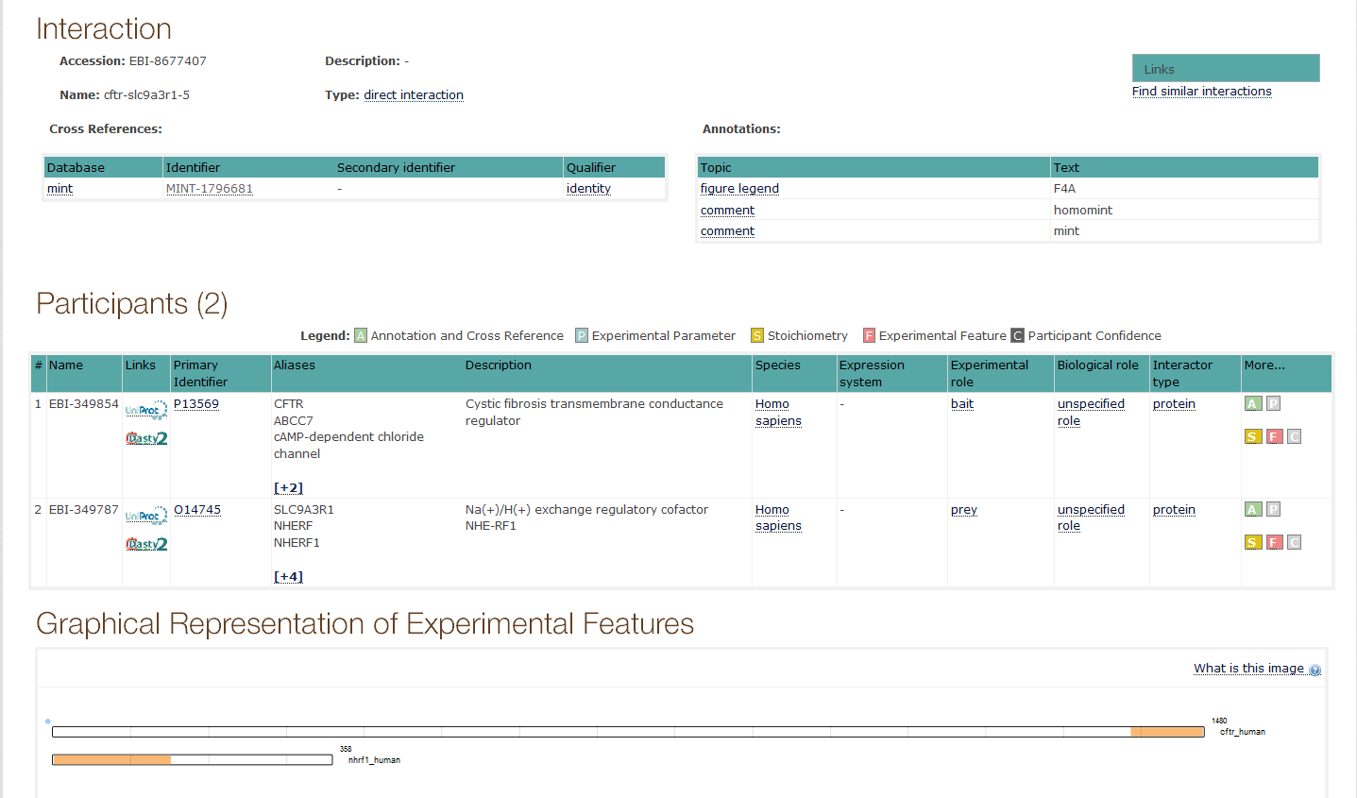
Interaction detail in IntAct

Slide 34
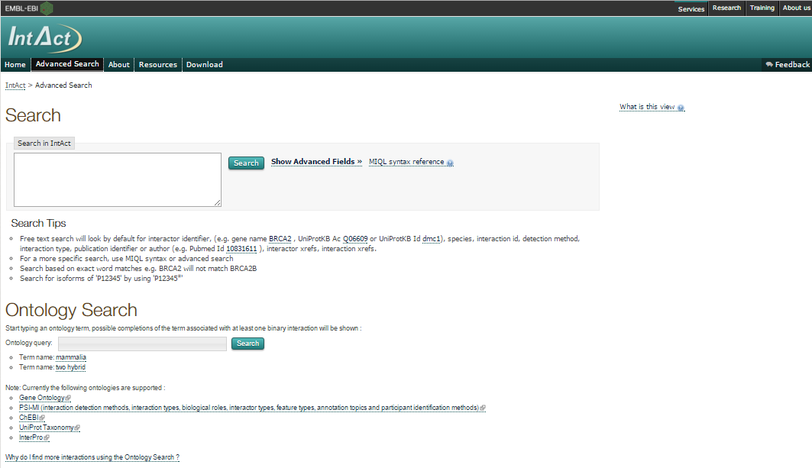
IntAct: Other searches

Slide 35
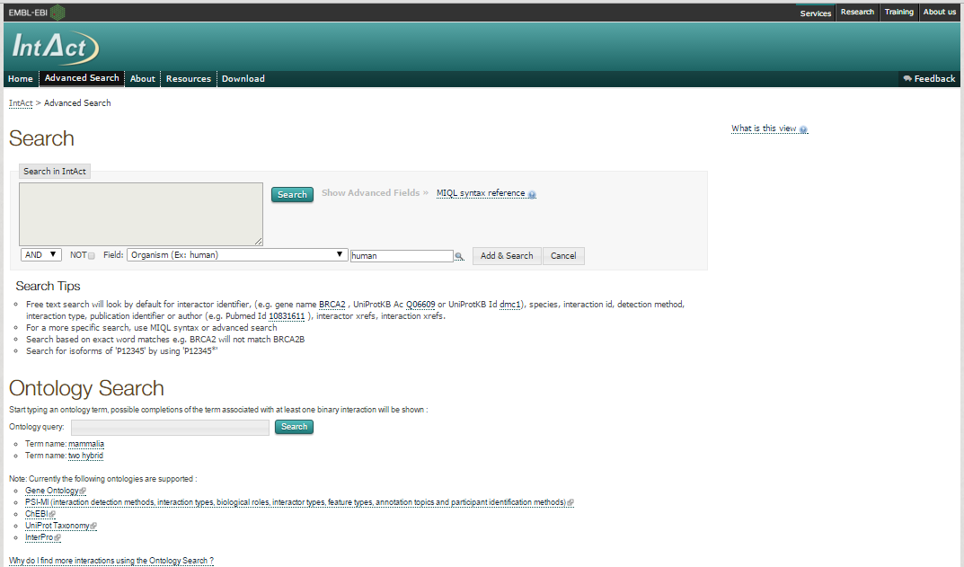
IntAct: Advanced search

Slide 36
IntAct: MIQL syntax search

Slide 37
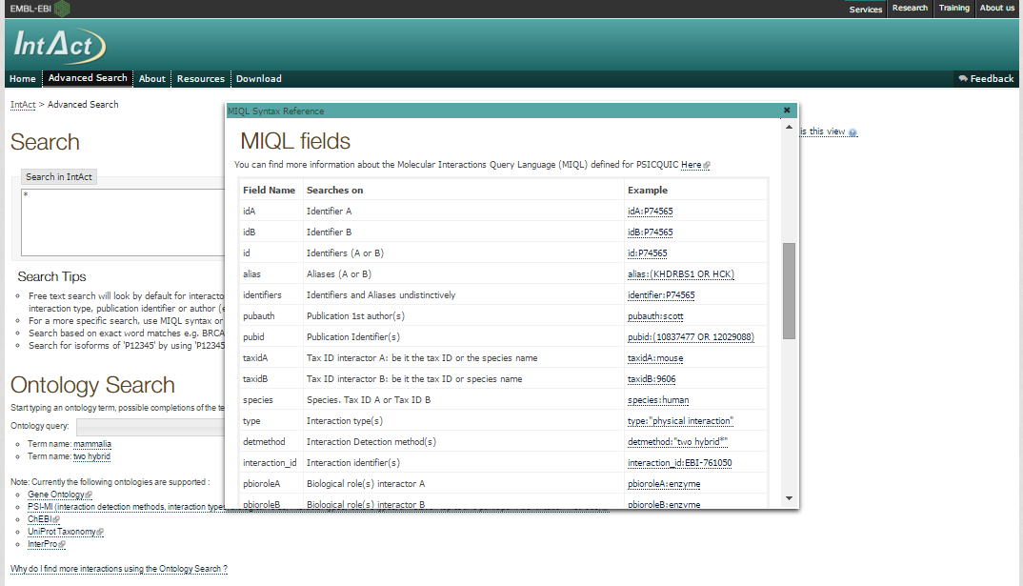
IntAct: MIQL syntax search

Slide 38
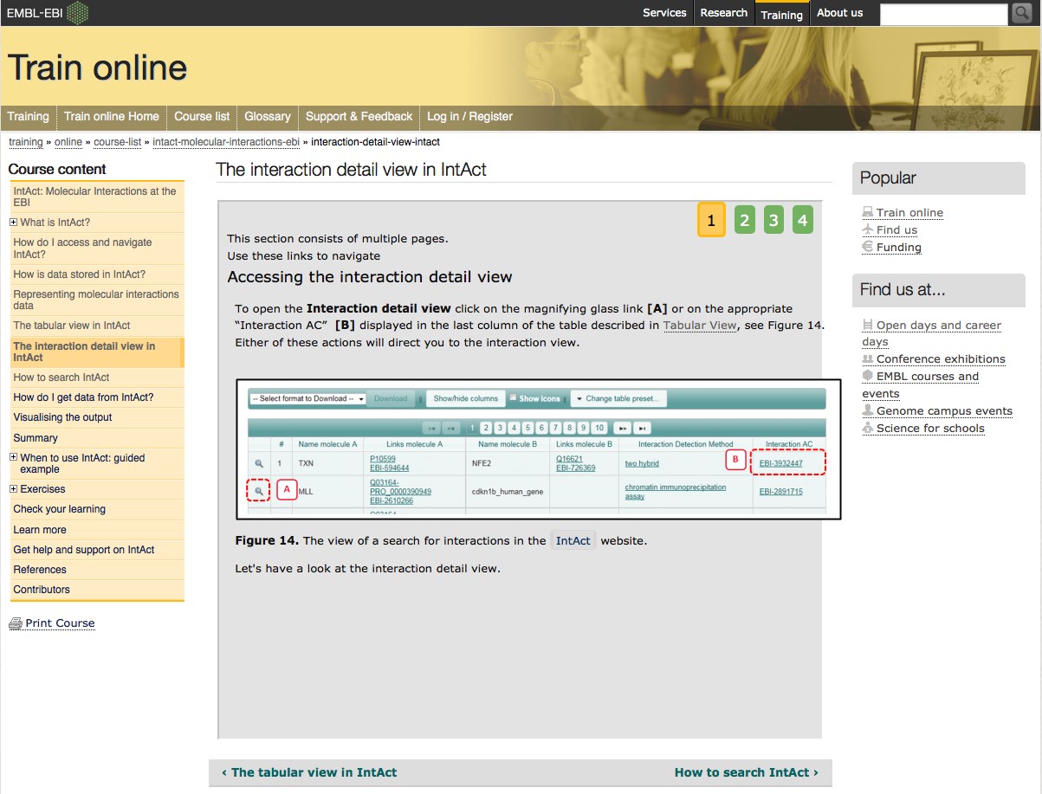
More about IntAct: on-line EBI courses
www.ebi.ac.uk/training/online/course/intact-molecular-interactions-ebi

Slide 39
The problem of data integration and an example of a solution: PSICQUIC
Sandra Orchard &
Pablo Porras Millán, IntAct
orchard@ebi.ac.uk
pporras@ebi.ac.uk

Slide 40
Molecular interaction information
Ideally
Reality
DB
DB
DB
DB
DB
I
I
I
I
I
Database
I
Interface
User
Notes:
As a biologist I would prefer to see all the information in one unique database.
Centralized databases have this mission.
The aim to collect all the information for one specific domain.
However …
Medium-size labs and organizations are capable to produce large amounts of data.
Then it becomes harder to submit data to centralized repositories.
Moreover data producers like to control and structure their own databases, developing their own GUI and access protocols.
For us, the users, it becomes harder to access the information.
For one specific domain we might find different databases, using different GUIs. We might end up downloading data in different formats complicating the integration of results. After integration we might find a problem of high redundancy in our results.

Slide 41

Molecular interaction resources
547 resources!
www.pathguide.org/

Slide 42
Utility of Bioinformatics
Scientific impact
Too little
bioinformatics
Too many databases
Too diverse interfaces
Tim Hubbard

Slide 43
Data integration
Combining data residing in different sources
… providing users with a unified view of these data.
Ideally
Reality
Compromise
DB
DB
DB
DB
DB
DB
DB
DB
DB
I
I
I
I
I
STANDARDS AND ONTOLOGIES
I
Database
I
Interface
User

Slide 44

The danger with standards…
From xkcd: http://xkcd.com/927/

Slide 45
Data integration problems
Many data resources
Many to maintain
New appearing
Just 20% has a sustained future*
Not easy to find them
Different query interfaces
Variable results
Formats
Schemas
Controlled vocabularies
Minimum information guidelines
Redundancy
Inconsistency
data integration?
* Merali et al., 2005, Nature, PMID: 15973369.

Slide 46
Collaboration among data providers
More data coverage
Less redundancy
Less inconsistency
Better data management
Access, exchange, sharing, portability, interoperability, annotation, comparison, verification, representation, integration, reusability.
IntAct
PRIDE
EMBL
…
…
InnateDB
GPMDB
NCBI
DDBJ
MINT
Tranche
DIP
PeptideAtlas
Nucleotide sequences
INSDC
Molecular interactions
IMEx
Protein indentifications
ProteomeXchange

Slide 47

Standards
PSI-MI standards
Common identifiers
Controlled vocabularies
Common formats
Common schemas
Minimum information guidelines
Common query interfaces
www.psidev.info/MI
Control vocabulary
Schema
Format
Identifiers
Reporting
guideline
Data distribution
Notes:
The Molecular Interactions workgroup is concentrating on:
improving the annotation and representation of molecular interaction data wherever it is published, be this in journal articles, authors web-sites or public domain databases
improving the accessibility of molecular interaction data to the user community. By using a common standard data can be downloaded from multiple sources and easily combined using a single parser

Slide 48
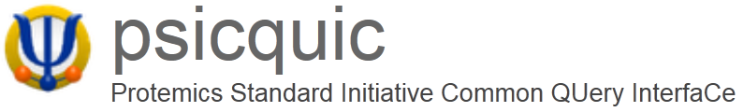





Unified query client: PSICQUIC
www.ebi.ac.uk/Tools/webservices/psicquic/view/main.xhtml
PSI-MI
MIQL
Interactions
Query
input
output
PSICQUIC
PSICQUIC
Service A
PSICQUIC
Service B
PSICQUIC
Service C
PSICQUIC
Registry

Slide 49









Examples of services using PSICQUIC
www.phisto.org
www.reactome.org
www.cytoscape.org
www.genemania.org
http://mentha.uniroma2.it
http://clipserve.clip.ubc.ca/topfind
http://cbdm.mdc-berlin.de/tools/hippie
www.ebi.ac.uk/Tools/webservices/psicquic/view/main.xhtml
www.bioconductor.org/packages/release/bioc/html/PSICQUIC.html

Slide 50

Unified query client interface: PSICQUIC view
www.ebi.ac.uk/Tools/webservices/psicquic/view/main.xhtml

Slide 51

Unified query client interface: PSICQUIC view

Slide 52

Unified query client interface: PSICQUIC view

Slide 53

Unified query client interface: PSICQUIC view

Slide 54

Unified query client interface: PSICQUIC view

Slide 55

PSICQUIC registry
www.ebi.ac.uk/Tools/webservices/psicquic/registry/registry?action=STATUS

Slide 56
PSICQUIC GAME
www.biotnet.org/training-materials/psicquic-game

Slide 57
Service Oriented Architecture
Services
IntAct
Biogrid
String
...
Registry
Clients
PSICQUIC view
Cytoscape
…
PSICQUIC Registry
Find
Publish
Format
DAS Clients
PSI-MI
PSICQUIC
sources
DAS Clients
PSICQUIC
sources
PSICQUIC
Clients
PSICQUIC
Services
query
MIQL
57
25/11/2015

Slide 58
User
Query
P2 or P6
LIM15 RAD51

Slide 59
Software/Client

Slide 60
Registry
Service Name | Service location

Slide 61
Service A
Name: ……………..…….
Molecule A | Molecule B | Detection method
P1 | P2 | Two hybrid
P2 | P2 | Coip
P3 | P4 | Coip
P3 | P5 | Coip

Slide 62
Service B
Name: ……………..…….
Molecule A | Molecule B | Detection method
P6 | P6 | Two hybrid
P7 | P9 | Coip
P8 | P6 | Coip
P9 | P10 | Coip

Slide 63
Service C
Name: ……………..…….
Molecule A | Molecule B | Detection method
P2 | P12 | Two hybrid
P6 | P12 | Coip
P11 | P9 | Coip
P6 | P4 | Coip

Slide 64
Service D
Name: ……………..…….
Molecule A | Molecule B | Detection method
P15 | P2 | Two hybrid
P6 | P6 | Coip
P14 | P13 | Coip
P15 | P2 | Coip

Slide 65
Solution
P8
P1
P2
P12
P6
P15
P4

Slide 66
Solution
Services
P8
P1
A
B,D
A
B
P2
C
P12
C
P6
D
C
P15
P4

Slide 67
Solution
Detection methods
P8
P1
Coip
Coip, Two Hybrid
Two Hybrid
Coip
P2
Two Hybrid
P12
Coip
P6
Coip, Two Hybrid
Coip
P15
P4

Slide 68
Network representation and analysis: strategies and limitations

Slide 69



Network analysis: background
Biological network analysis: originated using tools and concepts from network and graph theory and social network analysis.
Graph theory: set of abstract concepts and methods that can be used to visualize and analyse biological networks.
First formulation of graph theory: The problem of the seven bridges of Koenigsberg (Kaliningrad).
“Solved” by Leonard Euler in 1735.
Set the basis of graph theory and the idea of topology.
Images taken under Creative Commons Attribution-Share Alike 3.0 Unported license from:
http://commons.wikimedia.org/wiki/File:Konigsberg_bridges.png
http://commons.wikimedia.org/wiki/File:K%C3%B6nigsberger_br%C3%BCcken.svg

Slide 70




Network analysis in biology
Complex biological systems can be represented and analysed as networks, using the tools that graph theory gives us:
Ecological networks (food webs, species interaction networks…)
Neurological networks
Metabolic networks
Signalling networks
Genetic interaction networks
Gene regulatory networks
Protein-protein interaction networks
…
Images taken under Creative Commons Attribution-Share Alike 3.0 Unported license from:
http://commons.wikimedia.org/wiki/File:Lions_hunting_Africa.jpg
http://commons.wikimedia.org/wiki/File:Entner%E2%80%93Doudoroff_pathway_non-phosphorylative.svg
http://commons.wikimedia.org/wiki/File:Gene_Regulatory_Network_for_Initiation_of_Sporulation_in_Bacillus_subtilis.png

Slide 71
Example of a PPI Network
>80% of proteins are all connected in one giant cluster of PPI network
Small-world effect median network distance – 6 steps
Nodes – proteins
Edges – interactions

Slide 72
Properties of PPI networks
Small world effect - Interconnected binding networks could indiscriminately spread perturbations, how individual pathways can be turned on and off without upsetting the whole system ?
Transitivity/ Clustering - A network shows clustering if the probability of pair of nodes being adjacent is higher when the two nodes have a common neighbor.
Functions are likely to be carried out in a highly modular manner.
High clustering => High modularity
Notes:
NOT SO SURE ABOUT THIS ONE, CHECK WITH SANDRA

Slide 73


Properties of PPI networks
Scale-free effect - the majority of nodes in a scale-free network have only a few connections to other nodes, whereas some nodes (hubs) are connected to many other nodes in the network

Slide 74
Properties of PPI networks
Scale-free networks are stable - if failures occur at random and the vast majority of proteins are those with a small degree of connectivity, the likelihood that a protein hub would be affected is small.
Even if a hub-failure occurs, the network will generally not lose its connectedness, due to the remaining hubs.
However, if we loose a few major hubs from the network, the network is turned into a set of rather isolated graphs (so they are vulnerable to targeted attack).
Many cancer-linked proteins are hub proteins (e.g. P53).
Given the current limited coverage levels and variable quality of interaction data, the observed scale-free topology of existing interactome maps cannot be confidently extrapolated to complete interactomes.

Slide 75

Network analysis: typical workflows
Type I:
Enrichment of gene sets in pre-existing network

Slide 76

Network analysis: typical workflows
Type I:
Enrichment of gene sets in pre-existing network

Slide 77

Network analysis: typical workflows
Type II:
De novo network construction + clustering analysis

Slide 78

Network analysis: typical workflows
Type II:
De novo network construction + clustering analysis

Slide 79

Network analysis: typical workflows
Type II:
De novo network construction + clustering analysis

Slide 80

Network analysis: typical workflows
Type III:
Directional network analysis

Slide 81

Network analysis: typical workflows
Type III:
Directional network analysis

Slide 82

Network analysis: typical workflows
Type III:
Directional network analysis / network modeling

Slide 83







PPI Network analysis: building a network
primary databases
experimental data
meta-databases and predictive databases
Challenges:
Identifiers
Redundancies
Selection of the data
Type
Quality
Mapping external information

Slide 84


PPI Network analysis: filtering and enriching your data
Confidence filtering
Detection method
Number of publications
Confidence score
...
Overlaying external information
Expression data
Protein abundance
Enzymatic assay values
...

Slide 85




PPI Network topological analysis
Degree distribution
Average clustering coefficient distribution
Shortest path length distribution

Slide 86
PPI Network topological analysis
Betweenness centrality:
Measure of a node's centrality in a network.
Number of shortest paths from every end of the network that pass through that node.
Gives a good estimation of the importance of a node (protein) in a network (signalling, scaffolding…).

Slide 87




PPI Network topological analysis: cluster and motif search
Clustering search
Common motifs

Slide 88




PPI Network analysis: annotation enrichment analysis
GO:0019908:
nuclear cyclin-dependent protein kinase holoenzyme complex
REACT_821.2:
Cyclin D associated events in G1

Slide 89




PPI Network representation challenges
Blisson et al., 2011, Nature Biotechnology, PMID: 21706016.

Slide 90
Introduction to Cytoscape

Slide 91



Cytoscape: open-source network representation and analysis tool
www.cytoscape.org
2.8
3.2

Slide 92

Representing PPIs: Why Cytoscape?
www.cytoscape.org
It imports molecular and genetic interaction datasets in several formats.
We will import data from IMEx-complying databases to generate a molecular interaction network using the PSICQUIC Universal Client app of Cytoscape.
It can make use of several visual features that can effectively highlight key aspects of the network.
We will use node and edge columns to represent quantitative proteomics data and interaction features.
It can integrate global datasets and functional annotations.
We will make use of resources such as the Gene Ontology to annotate the interacting partners in our network.
It has a wide variety of advanced analysis and modelling tools in the form of apps that can be easily installed and applied to different approaches.
The BiNGO and clisterMaker2 apps will be used to perform GO enrichment analysis and try to identify the functional modules underlying our network.

Slide 93

Cytoscape apps/plugins
Large variety of apps/plugins (>230)
Great flexibility, adaptable to multiple types of analysis, in various domains of knowledge: bioinformatics, social network analysis, semantic web…
Possibility to create your own.
Some deprecated or obsolete
Different functionality depending on the Cytoscape version
“A travel guide to Cytoscape plugins.”
Saito et al., 2012, Nature Methods, PMID: 23132118.

Slide 94
Building and analyzing networks with Cytoscape and PSICQUIC

Slide 95
Workflow
Obtain protein-protein interactions
PSICQUIC-based interaction import client in Cytoscape
Visualize network
Cytoscape
Basic network analysis
Filtering your network based on columns
Cytoscape: Using filters
Integrate quantitative proteomics information in the network
Cytoscape: Load columns
Identify heavily connected sub-networks
Cytoscape: clusterMaker2 app
Analyze meaningful GO annotation
Cytoscape: BiNGO app

Slide 96

Workflow
Base PPI network
List of proteins (seed)
Topological clustering
Annotation enrichment

Slide 97






Our dataset
PMID: 24454774
MWCNTs treatment
Time points:
2 hours
12 hours
24 hours
30 µg/mL
3 µg/mL
control
0.3 µg/mL
Output value:
Relative abundance of proteins
(significant p<0.05)

Slide 98
Workflow
Obtain protein-protein interactions
PSICQUIC-based interaction import client in Cytoscape
Visualize network
Cytoscape
Basic network analysis
Filtering your network based on columns
Cytoscape: Using filters
Integrate quantitative proteomics information in the network
Cytoscape: Load columns
Identify heavily connected sub-networks
Cytoscape: clusterMaker2 app
Analyze meaningful GO annotation
Cytoscape: BiNGO app

Slide 99


Importing interaction data through PSICQUIC
Cytoscape
File → Import → Network → Public Databases…
copy & paste

Slide 100
Importing interaction data through PSICQUIC
Cytoscape
File → Import → Network → Public Databases…
Select source databases

Slide 101
Importing interaction data through PSICQUIC
IMEx-complying databases
IntAct
MINT
MatrixDB
DIP
I2D-IMEx
UniProt
BHF-UCL
MolCon
InnateDB-IMEx

Slide 102

Importing interaction data through PSICQUIC

Slide 103

Importing interaction data through PSICQUIC

Slide 104
Workflow
Obtain protein-protein interactions
PSICQUIC-based interaction import client in Cytoscape
Visualize network
Cytoscape
Basic network analysis
Filtering your network based on columns
Cytoscape: Using filters
Integrate quantitative proteomics information in the network
Cytoscape: Load columns
Identify heavily connected sub-networks
Cytoscape: clusterMaker2 app
Analyze meaningful GO annotation
Cytoscape: BiNGO app

Slide 105

Visualizing the network
1
2

Slide 106

Visualizing the network
Layout → yFiles Layouts → Organic

Slide 107

Find a layout that sorts your network nodes by the number of interactions that each one of them has.

Slide 108
Workflow
Obtain protein-protein interactions
PSICQUIC-based interaction import client in Cytoscape
Visualize network
Cytoscape
Basic network analysis
Filtering your network based on columns
Cytoscape: Using filters
Integrate quantitative proteomics information in the network
Cytoscape: Load columns
Identify heavily connected sub-networks
Cytoscape: clusterMaker2 app
Analyze meaningful GO annotation
Cytoscape: BiNGO app

Slide 109

Cytoscape: columns and visual styles
columns hold information about nodes and edges in Cytoscape.
They can be used to create and apply visual styles, allowing for visualization of complex information.
Node columns
Edge columns
Protein name: pp60c-src
Relative expression value: -3.23
Organism: human
Interaction detection method: anti-bait coIP
Confidence score: 0.24
Interaction type: physical association
Database: IntAct

Slide 110

Cytoscape: columns and visual styles
Network after application of a visual style based on its columns
Node columns
Label: Protein name
Colour: Relative expression value
Size: Seed yes/no
Border: Protein family
Edge columns
Label: Interaction detection method
Colour: Interaction type

Slide 111

Table panel: nodes

Slide 112

Table panel: edges

Slide 113

Using selection / filters
In ‘Control Panel’ go to the ‘Select’ tab

Slide 114


Using selection / filters

Slide 115
Use edge columns to create a network in which all the interactions have been found using the ‘two hybrid’ interaction detection method.

Slide 116
Workflow
Obtain protein-protein interactions
PSICQUIC-based interaction import client in Cytoscape
Visualize network
Cytoscape
Basic network analysis
Filtering your network based on columns
Cytoscape: Using filters
Integrate quantitative proteomics information in the network
Cytoscape: Load columns
Identify heavily connected sub-networks
Cytoscape: clusterMaker2 app
Analyze meaningful GO annotation
Cytoscape: BiNGO app

Slide 117

Our dataset: columns table
Table2_formatted.xlsx

Slide 118

Importing columns to Cytoscape
File → Import → Table → File…

Slide 119
Try to create a sub-network to see how the proteins that are over-represented after 12 hours of treatment with 30 µg/ml of MWCNTs are connected.
Make use of filters and the ‘Create new networks for selected nodes, all edges’ function.
Try first picking only those protein for which you can find values and then try again creating a network including their 1st-level interacting partners.

Slide 120

Using Styles

Slide 121
Try creating a new network in which you represent the relative quantification of the proteins affected by the exposure to 30 µg/ml of MWCNTs after 24 hours.

Slide 122
Workflow
Obtain protein-protein interactions
PSICQUIC-based interaction import client in Cytoscape
Visualize network
Cytoscape
Basic network analysis
Filtering your network based on columns
Cytoscape: Using filters
Integrate quantitative proteomics information in the network
Cytoscape: Load columns
Identify heavily connected sub-networks
Cytoscape: clusterMaker2 app
Analyze meaningful GO annotation
Cytoscape: BiNGO app

Slide 123


Topological clusters
Transitivity/ Clustering - A network shows clustering if the probability of pair of nodes being adjacent is higher when the two nodes have a common neighbor.
Functions are likely to be carried out in a highly modular manner.
High clustering => High modularity
Ubiquitin-proteasome system network
Proteasome cluster
Notes:
NOT SO SURE ABOUT THIS ONE, CHECK WITH SANDRA

Slide 124
Network topological analysis: clustering methods
Glay community clustering
Implementation of the Newman-Girvan fast greedy algorithm.
The algorithm identifies clusters by iteratively removing edges from the network and then checking to see which nodes are still connected.
MCODE
Finds highly interconnected regions in a network. The algorithm uses a three-stage process:
Weighting: gives a higher score to those nodes whose neighbours are more interconnected.
Molecular complex prediction: starting with the highest-weighted node (seed), recursively move out, adding nodes to the complex that are above a given threshold.
Post-processing, which applies filters to improve the cluster quality (haircut and fluff).
Check http://www.youtube.com/watch?v=7wA4ZEoFGl8 and http://www.cgl.ucsf.edu/cytoscape/cluster/clusterMaker.html#mcode.

Slide 125
clusterMaker: selecting the algorithm
Apps → clusterMaker → Community cluster (GLay)
Notes:
We are now going to work with the main large cluster and ignore the orphan interactions around the periphery.
If you have installed clusterMaker, then in the Plugins menu, there will be an option called “Cluster”. We are going to use a clustering algorithm called “Community Cluster”.
Select the central large
Go to Plugins → Cluster → Community cluster (GLay).

Slide 126

clusterMaker2: creating the clusters
Notes:
A window will now appear, presenting the options for Community Cluster. We are going to accept the default options. Click the “Create Clusters” button.

Slide 127

clusterMaker2: visualizing the clusters
Apps → clusterMaker Visualizations→ Create New network from Clusters
Notes:
When Community Cluster is finished, it reports to us what it has found. Note that unlike some other clustering algorithms, we don’t have to tell Community Cluster how many clusters to find. Instead Community Cluster will report to use how many clusters it thinks there are.

Slide 128
clusterMaker2: visualizing the clusters
Notes:
The Visualize Clusters button was previously grayed out. Now the clusters have been identified, the “Visualize Clusters” button is active. Click it to display the clusters the algorithm has found.

Slide 129
Try to repeat the clustering search using MCODE this time.
What is the main difference to Glay?
Try different values for the advanced parameters in MCODE and see how that affects your results.

Slide 130
Workflow
Obtain protein-protein interactions
PSICQUIC-based interaction import client in Cytoscape
Visualize network
Cytoscape
Basic network analysis
Filtering your network based on columns
Cytoscape: Using filters
Integrate quantitative proteomics information in the network
Cytoscape: Load columns
Identify heavily connected sub-networks
Cytoscape: clusterMaker2 app
Analyze meaningful GO annotation
Cytoscape: BiNGO app

Slide 131




Gene ontology
http://geneontology.org/
What is the gene ontology?
Organized, controlled vocabulary of terms that describe gene products characteristics.
Example:
GO terms for Caspase 9

Slide 132




Gene ontology enrichment analysis

Slide 133
Gene ontology enrichment analysis
BiNGO performs a hypergeometric test to find out which functional categories are over- or under-represented in our dataset and which proteins are annotated with such categories, giving a table of results as an output. The test can be referenced to the whole ontology or to the network itself.
Additionally, BiNGO draws the over-represented categories as a Cytoscape graph, in which the relationships between different terms is depicted.
BiNGO can be used with lists of genes/proteins, whole networks or network sub-sections, making it easy to combine with other Cytoscape functionalities.

Slide 134

Gene ontology enrichment analysis
Apps → BiNGO

Slide 135

Gene ontology enrichment analysis
1
2
3
4

Slide 136



Gene ontology enrichment analysis

Slide 137


Gene ontology enrichment analysis
Choose Layouts → Cytoscape Layouts → Hierarchical layout
Child terms
negative regulation of transcription from RNA polymerase II promoter
granularity
regulation of macromolecule metabolic process
Parent terms

Slide 138
Final test
The output of the analysis as we have performed it is terribly complicated. Try to repeat it using the generic GOSlim ontology that is provided in the file ‘goslim_generic.obo’.
How does the analysis look like now?
Which processes are specifically over-represented in those proteins over-represented proteins in cells exposed to 30 µg/mL of MWCNTs in the 12 hours time point?
Repeat the BiNGO analysis and find out which processes are involving proteins connected to over-represented proteins in cells exposed to 30 µg/mL of MWCNTs in the 12 hours time point.
What is the difference between the results of these two analysis?
Combine the ontology enrichment and the cluster analysis to try to figure out the functionality behind the different topological clusters found by clusterMaker2. Check for clusters where over/under-represented proteins are especially prominent to find functional modules potentially different cells exposed to different doses of MWCNTs at different time points.

Slide 139






Acknowledgements
MI Team leader
Developing team
Sandra Orchard
Max Koch
Curation team
All files accessible at
www.ebi.ac.uk/~pporras/teaching_materials/network_analysis_liv_2015.zip
Margaret Duesbury
Birgit Meldal
Mariaestela Ortiz

